Slide 1
Muni University
BACHELOR OF INFORMATION SYSTEMS DEGREE
Year 3, Semester 2
Course Name: Data Warehousing and Business Intelligence
Course Code: ISM 3203
Samuel OCEN

Slide 2
Technical Architecture Design
Architecture concepts
Topology options: independent data marts, enterprise data warehouse, and the conformed data warehouse
Common components and functionality: ETL system; presentation servers (RDBMS/OLAP); real time options: direct to source, ODS, real time layer; BI application types and services
Creating the architecture plan

Slide 3
Architecture concepts
In IT perspective, an architecture adds value in much the same way as blueprints for a construction project.
The benefits include:
Greater likelihood of satisfying business requirements.
Communication; the plan is an excellent communications tool at several levels.
Planning; it provides a crosscheck for the projects plan.
Flexibility, productivity, and maintenance; it helps in anticipating
potential issues and building systems that can handle those issues
as a matter of course, rather than having to stop and rework after problem surface.
Learning; through documentation, new team members get up to speed more quickly on the components, contents, and connections.

Slide 4
Architecture concepts
Technical Architecture Overview
The Kimball technical system architecture separates the data and processes comprising the DW/BI system into the backroom extract, transformation and load (ETL) environment and the front room presentation area, as illustrated in Fig. 1.
The Kimball technical system architecture focuses on the following components:
Backroom ETL system
the ETL process is grouped into four major operations: extracting the data from the sources, performing cleansing and conforming transformations, delivering it to the presentation server, and managing the ETL process and back room environment.
Front room presentation area
It is presumed that the data utilized by the BI applications is dimensionally- structured, organized by business process, atomically-grained (complemented by aggregated summaries for performance tuning), and tied together by the enterprise data warehouse bus architecture, as described earlier on this page.

Slide 5
Architecture concepts Technical Architecture Overview
The Kimball technical system architecture focuses on the following components:
Front room BI applications
The front room is the public face of the DW/BI system; it’s what business users see and work with day-to-day. There’s a broad range of BI applications supported by BI management services in the front room, including ad hoc queries, standardized reports, dashboards and scorecards, and more powerful analytic or mining/modeling applications.
Metadata
Metadata is all the information that defines and describes the structures, operations, and contents of the DW/BI system. Technical metadata defines the objects and processes which comprise the DW/BI system. Business metadata describes the data warehouse contents in user terms, including what data is available, where did it come from, what does it mean, and how does it relate to other data. Finally, process metadata describes the warehouse’s operational results.

Slide 6
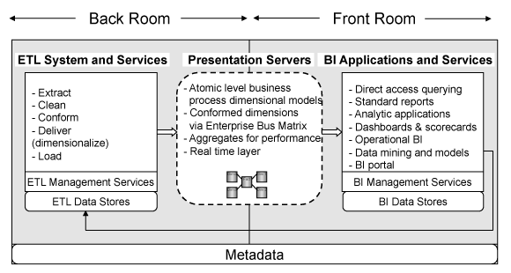
Architecture concepts
Figure 1: Kimball technical system architecture diagram.
Source: https://www.kimballgroup.com/data-warehouse-business-intelligence-resources/kimball-techniques/technical-dw-bi-system-architecture/

Slide 7
Architecture concepts Does DW/BI Architecture Evolve?
The DW/BI architecture plan evolve, as the business requirements change, new data becomes available, and new technologies emerge in the market place.
The ability of the business users to pressurize the DW/BI designer to make significant changes to the project determines the its success.
The architecture evolves over time as deep understanding, of the business and technology, is made.

Slide 8
Topology options
Topology options
Independent data marts
Enterprise data warehouse, and
Conformed data warehouse

Slide 9
Common components and functionality
Common components and functionality: ETL system;
presentation servers (RDBMS/OLAP); real time options:
direct to source, ODS, real time layer; BI application types and services
ETL system
As shown Fig. 1, ETL processing occurs in the back room of the High Level DW/BI System Architecture Model.
The key concern of the ETL architects, developers, and DBAs in the back room is getting the right data from one point to another with timely and appropriate transformations.

Slide 10
Common components and functionality
ETL system
General ETL requirements
Productivity support
ETL system needs to provide basic development capabilities, like code
library management check in/check out, version control, and production and development system builds.
Usability
ETL system must be usable regardless of any system complexities.
Metadata driven
Services that support ETL processes should be metadata driven.
Services should draw from a repository of information about the
tables, columns, mappings, transformations, data quality screens,
jobs, and other components rather than embed this information in
the ETL tool or SQL code where it is almost impossible to find and change.

Slide 11
Common components and functionality
ETL system
Back room or ETL services are tools and techniques employed to support the ETL process.
ETL process involve operations:
Extracting the data from the sources
Running data through a set of cleansing and conforming transformation processes
Delivering data to the presentation server, and
Managing the ETL processes and back room environment
DW/BI total development time includes
Understanding the source data formats
Data profiling
Data cleansing
Unit testing
System testing
Placing into production, and
Documentation

Slide 12
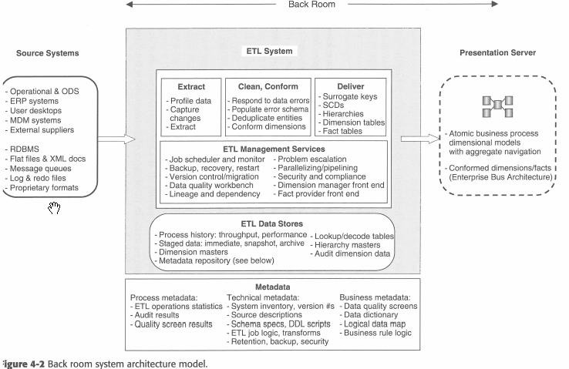
Common components and functionality
ETL system
Back room ETL flow
Data moves from the source systems through the ETL processes and into the presentation server.
Figure 2: Back room system architecture model
Source: Kimball
Thur, February 20, 2020
12

Slide 13
Common components and functionality
ETL system
Source systems
Data comes from multiple sources e.g.
Core operational systems
Order entry
Production
Shipping
Customer service
Accounting system
External sources
Customer demographic information
Target customer lists
Commercial business segments, and
Competitive sales data
Enterprise Resource Planning
Operational Data Stores
Reporting Operational Stores
Master Data Management
XML Sources
Manage Queues, Log File, and Redo Files
Proprietary Formats
Thur, February 20, 2020
13

Slide 14
Common components and functionality
ETL system
Extract
The main task is determining the data to extract and the kinds of filters to apply.
Related ETL functions
Data profiling
Change data capture
Extract system
Clean and conform
Cleaning and conforming services are the core of the data quality work that takes place in the ETL process.
A range of transformation steps are performed to convert the data into
something valuable and presentable to the business.
Major services
Data cleansing system
Error event trucking
Audit dimension creation
Deduplicating
Thursday, February 20, 2020conforming
14

Slide 15
Common components and functionality
ETL system
Deliver
This involves preparing data for user consumption and delivering it to the presentation servers.
Some of the ETL subsystems
Slowly changing dimension (SCD) manager
Surrogate key generator
Hierarchy manager
Fact table builder, etc.
ETL Management Services
The final set of ETL modules which are responsible for general
development environment, like security
Some of the ETL subsystem
Job scheduler
Backup system
Recovery and restart
Version control
Version migration, etc.

Slide 16
Common components and functionality
ETL system
ETL Data stores
Data stores are the temporary or permanent landing places for data across the DW/B system.
Actual data stores are generated depending on the business requirements, the stability of the source systems, and complexity of your extract and transformation process.
Subsystems
ETL system data stores
Lookup and decode tables
Data quality data stores

Slide 17
Common components and functionality
ETL system
ETL data store specifications and
DDL scripts, etc.
Business metadata
Data quality screen specifications
Data dictionary
Logical data map
Business rule logic
ETL Metadata
Grouped into 3 categories:
Process metadata
ETL operations statistics
Audit results
Quality screen results
Technical metadata
System inventory version numbers
Source system descriptions
Source access methods

Slide 18
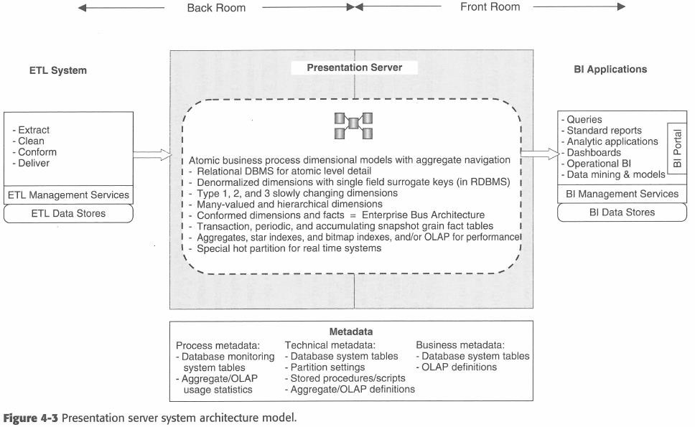
Common components and functionality
Presentation servers (RDBMS/OLAP)
Figure 3: Presentation server system architecture model
Source: Kimball
Thur, February 20, 2020
18

Slide 19
Common components and functionality
Presentation servers (RDBMS/OLAP)
Business requirements
Access to data from all major business processes
Access to both summary and atomic data
Single source for analytic data
Detail Atomic data
The foundation of presentation server is based on atomic level business process dimensional models.
The starting point should always be the lowest level of detail.
Aggregates
Many organizations have fairly large datasets; users would wait have to wait for a long time before any summary query to return.
To improve performance at the summary levels, a second element of the presentation layer know as aggregates is added.
Preprogramming data during the loading process improves performance fro analytic queries.

Slide 20
Common components and functionality
Presentation servers (RDBMS/OLAP)
Aggregates
Many organizations have fairly large datasets; users would wait have to wait for a long time before any summary query to return.
To improve performance at the summary levels, a second element of the presentation layer know as aggregates is added.
Preprogramming data during the loading process improves performance fro analytic queries.
The aggregates may either occupy separate logical layer or may be implemented in the relational database, in an OLAP server, or a separate application server.
Aggregates serve as indexes and their choice is time-dependent and is based on the analysis of actual query usage.

Slide 21
Common components and functionality
Presentation servers (RDBMS/OLAP)
Aggregate Navigation
Aggregates and atomic data increases the complexity of the data environment.
Users should find a system easy to use.
Aggregates should be transparent to user queries and BI applications developers.
Aggregate navigators improve query performance.
Technologies for implementing aggregate navigation functionality include:
OLAP engines
Materialized views in the relational database with optimizer-based navigation.
Relational OLAP (ROLAP) services.
BI application servers or query tools.

Slide 22
Common components and functionality
Presentation servers (RDBMS/OLAP)
The three components:
Atomic level business process dimensional models
Performance aggregates and
Aggregate navigator, allow users to transparently query the data at nay level of detail for any available business process without prior knowledge of the existing aggregates with results received in a reasonable timeframe.

Slide 23
Common components and functionality
Presentation servers (RDBMS/OLAP)
Design disciplines within the presentation server
Denormalized dimension tables with single field surrogate keys
Many-valued and hierarchical dimension
Conformed dimensions and facts based on the enterprise bus architecture
Aggregates, star indexes, bitmap indexes, and/or OLAP for performance, etc.
Adjusting the presentation server architecture
Vertical partitioning vs, horizontal partitioning
Vertical partitioning; breakup the presentation layer into separate platforms-server for atomic data, server for aggregate data, server for aggregate management and navigation.
Horizontal partitioning; distribute the load based on dataset.

Slide 24
Common components and functionality
Presentation servers (RDBMS/OLAP)
Organizational consideration
Data source split usually occurs when there are few organizational overlaps, like two separate lines of business that don’t share conformed dimensions.
Solution: implement two parallel, dedicated DW/BI systems
Business group split usually happens when a group has a BI application opportunity that needs certain data, calculations, or aggregations and the central DW/BI team is too busy to respond.
Solution: local analytic data stores may be built and managed independently by IT resources that are dedicated to the business group, or even by power users with desktop database tools.

Slide 25
Common components and functionality
Presentation servers (RDBMS/OLAP)
Presentation Server metadata
Process metadata
Database monitoring system tables containing information about the use of tables throughout the presentation server.
Aggregate usage statistics including OLAP usage
Technical metadata
Database system tables containing RDBMS table, column, view, index, and security information
Partition settings including partition definitions and logic for managing them over time.
Stored procedures and SQL scrips for creating partitions, indexes, and aggregates, as
well as security management.
Aggregate definition containing the definitions of system entities such as materialized
views, as well as other information necessary for the query re-write facility of the aggregate navigator
OLAP system definitions containing system information specific to OLAP databases
Target data policies and procedures including retention, backup, arcvive, recovery,
ownership, and security settings.

Slide 26
Common components and functionality
Presentation servers (RDBMS/OLAP)
Presentation Server metadata
Business metadata
This is provided by the BI application’s sematic layer, the OLAP definitions, or the database system table and column definition directly.

Slide 27
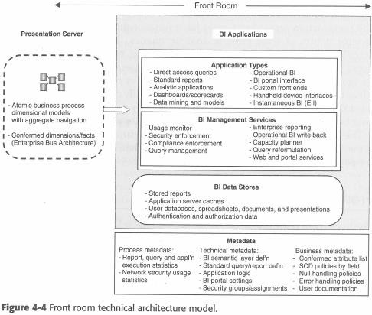
Common components and functionality
Front Room Architecture
Business users see and interact with this architecture.
Business Intelligence(major role)
Reports, Cube Explorers, Data mining, Dashboards, Scorecards.
Figure 4: Presentation server system architecture model
Thur, February 20, 2020
27
Source: Kimball

Slide 28
Common components and functionality
Infrastructure
Provides the underlying foundation for all of the architectural elements.
It includes the hardware, network, and lower level functions like security.
Infrastructure drivers
Technical and system issues
Policy and organizational issues
Expected growth rate

Slide 29
Common components and functionality
Back rom and presentation infrastructure factors
Data size
Volatility
Number of users
Number of business processes
Nature of users
Service level agreements
Technical readiness
Software availability
Financial resources

Slide 30
Common components and functionality
Parallel processing hardware architectures
Three basic parallel processing hardware architectures
Symmetric Multiprocessing (SMP)
Massively parallel process (MPP)
Non-Uniform Memory Architecture (NUMA)
Hardware performance boosters
Disk issues
Memory
CPUs
Secondary storage
Database platform factors
Characteristics of relational engine
Characteristics of OLAP engines

Slide 31
Common components and functionality
Front room infrastructure factors
Application consideration
Memory
Disk
Platform sharing
Desktop consideration
Cross-platform support
Desktop operations system and software
Memory
Connectivity and networking issues
Bandwidth
Remote access
File transfer
database connectivity
Direct services

Slide 32
Common components and functionality
Metadata integration (Find out what is about)
Security
Security vulnerabilities
Threats to physical assets
Threats to information and software assets
Threats to business continuance
Denial of service (DoS) attack
Inability to reconstruct consistent software snapshot
Terrorism
Network threats
DoS
Viruses, worm, and Trojan horses
Hijacking
Spoofing
Phishing
Backdoor or trapdoors

Slide 33
Common components and functionality
Real time options
Direct to source
ODS
Real time layer

Slide 34
Technical Architecture Design
Creating the architecture plan
The DW/BI application architecture design process unfolds in a series of eight steps;
Form an architecture task force
Gather architecture – related requirements
Create a draft architectural implications document
Create the architecture model
Determine the architecture implementation phases
Design and specify the subsystem
Create the application architecture plan document
Review the draft

Slide 35
Thank you!
End

